Slide 1
Some Bioactive Components of Algae: Fundamentals and Trends
Assoc. Prof. Dr. Seher Dirican
Sivas Cumhuriyet University
Faculty of Science
Department of Biology
58140 Sivas – Turkey
E-mail: sdirican@cumhuriyet.edu.tr

Slide 2
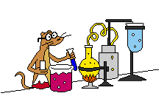
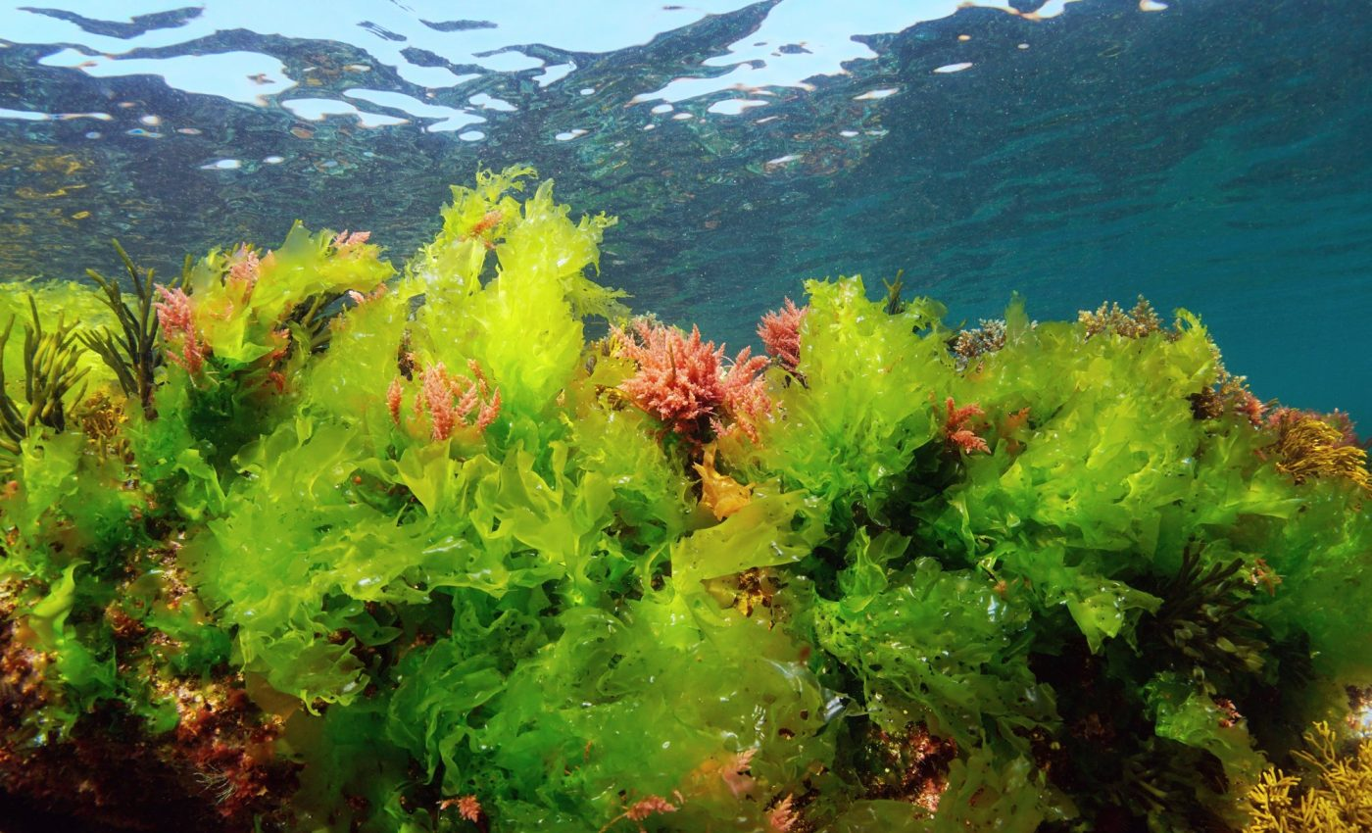
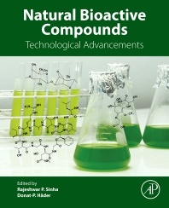
1. Introduction
Bioactive components are important compounds of the secondary metabolism of plants, animals, microorganisms and aquatic organisms are metabolites that exhibit various biological effects in living organisms. In order to obtain bioactive components, a process called extraction is used (Taşkıran et al. 2023).
The interest in the use of bioactive components obtained from algae is increasing day by day in the world.

Slide 3
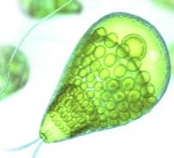
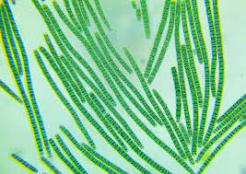
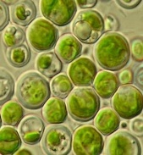
2. Some Bioactive Components of Algae
2.1. Fatty Acids
Algal species living in the sea consist of fatty acids with longer chains and more than two double bonds compared to algae living in freshwater (Bayizit et al. 2001).
Omega-3 fatty acids are first synthesized by algae living in water such as Dunaliella salina, Spirulina platensis, Chlorella pyrenoidosa. These fatty acids then accumulate in increasing amounts by passing through the food chain into the bodies of various zooplankton, mussels, oysters, shrimps and fish (Öztürk 2014).
Algal species such as Chlorella minutissima, Crypthecodinium cohnii, Dunaliella tertiolecta, Euglena gracilis, Porphyridium cruentum, Monodus subterraneus, Navicula saprophilla, Nitzschia ovalis, Nannochloropsis gaditana, Phaedactylum tircornatum, Spirulina platensis, Spirulina maxima and Thalassiosira sp. are commercially produced because they contain high amounts of essential fatty acids (Eryalçın, 2011).

Slide 4
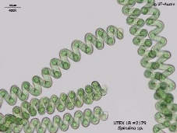
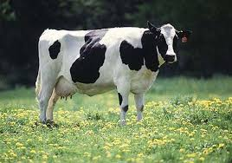
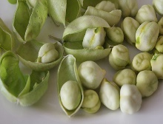
2.2. Proteins
Algae are very rich in protein. In particular, the Spirulina contains up to 70% protein in dry mass, much higher than the common sources of protein: beef (17%), fish (20%), eggs (47%), soybeans (35%) and chickpeas (18%) (Zhou et al. 2022; Eilam et al. 2023). According to these ratios, Spirulina contains much more protein than other terrestrial plants such as soybeans and chickpeas, as well as beef, fish and eggs.
At the same time, algae proteins contain high levels of essential amino acids. Algae have become an alternative and functional product that can replace animal protein in recent years due to their protein and other nutrients.

Slide 5
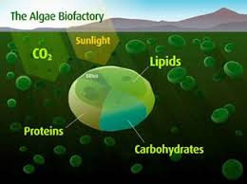
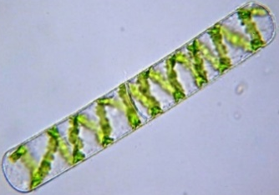
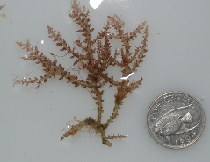
2.3. Carbonhydrates
Algae play an important role in the global carbon cycle through photosynthesis and achieve sustainable production. Carbohydrates are the main product of photosynthesis. Carbohydrates have different physiological roles in algae development and growth. Some algae species can increase their carbohydrate content.
While carbohydrates are 4% in Dunaliella bioculata, they increase up to 64% in Spirogyra sp. Similarly, carbohydrates are 11% in Acanthophora spicifera and can increase up to 56% in Caulerpa laetevirens (Sarkar et al. 2024).

Slide 6
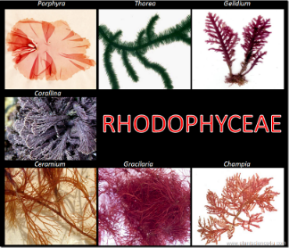
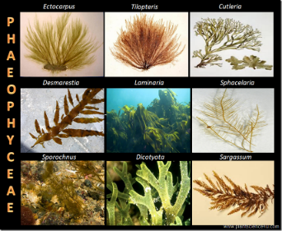
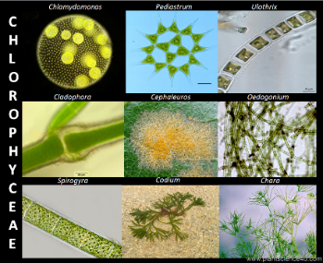
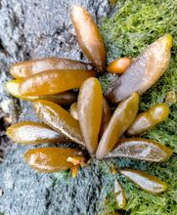
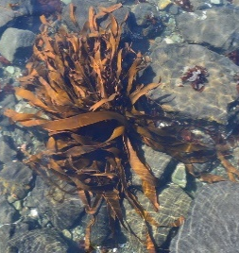
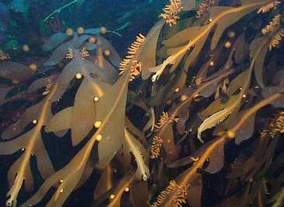
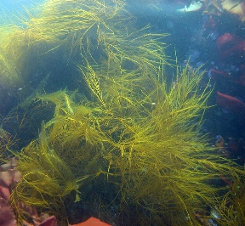
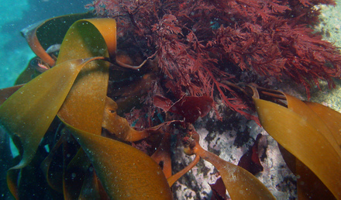
2.4. Sterols
Sterols are naturally present in the structure of algae. Unlike higher plants, algae contain various sterols of different structures (Akyıl et al. 2016).
High amounts of fucosterol are found in algae species such as Rhodophyceae, Phaeophyceae and Chlorophyceae. The presence of ergosterol, brassicasterol, fucosterol, beta-sitosterol, campesterol, cholesterol and stigmasterol has been detected in Phaeophyceae species such as Adenocystis utricularis, Ascoseira mirabilis, Cystosphaera jacquinotii, Desmarestia anceps, Desmarestia antarctica and Himantothallus grandifolius (Pereira et al. 2017).

Slide 7
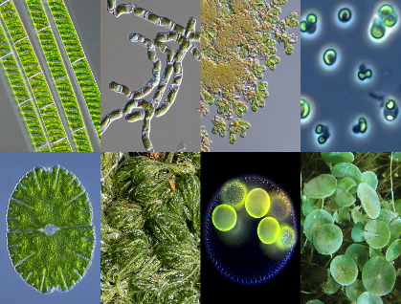
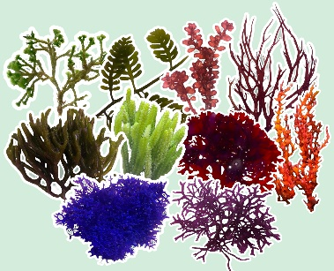
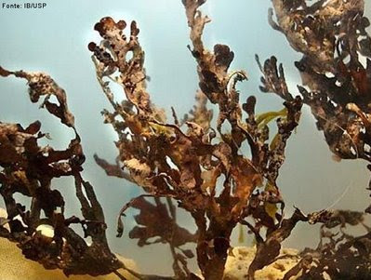
2.5. Phenolic Compounds
Phenolic compounds give algae their unique sour taste and color. There are many phenolic compounds in algae.
Vidalol A and B, which are bromophenolic compounds with anti-inflammatory effects, are isolated from Vidalia obtusaloba, a red alga (Keskinkaya and Akköz, 2018).

Slide 8
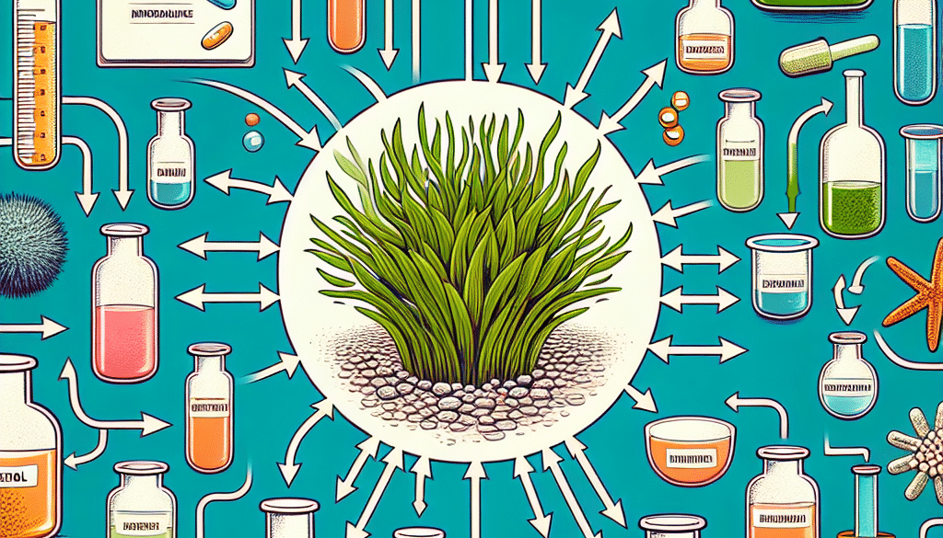
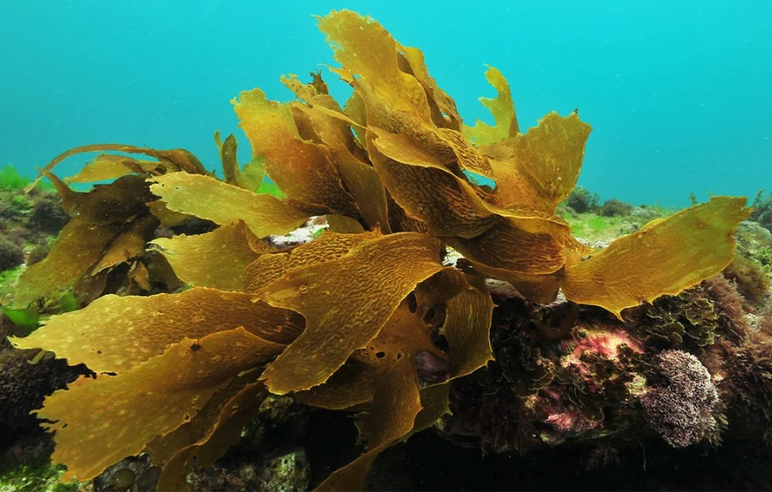
2.6. Antioxidants
There are many types of antioxidants, especially in fresh algae.
In particular, Ecklonia cava, a brown algae, has a significant antioxidant potential (Farruggia et al. 2018).

Slide 9
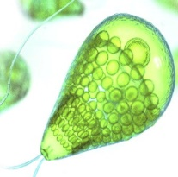
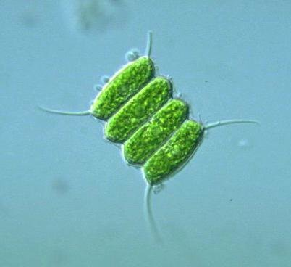
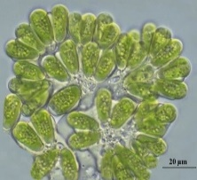
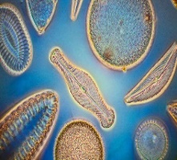
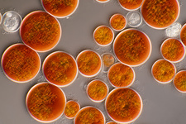
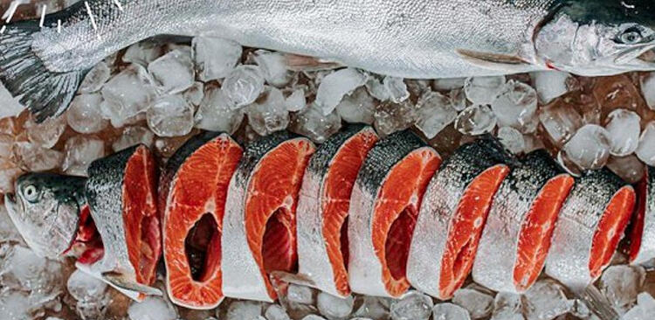
2.7. Pigments
Thanks to the pigments in their structures, algae perform photosynthesis. The colors of algae come from the different pigments they contain. Natural pigments are chlorophyll, carotenoids and phycobilins. The most commonly used algae in industrial applications for obtaining carotenoids are Chlorella, Spirulina, Dunaliella, Scenedesmus, Haematococcus, Botryococcus and Diatoms (Sasa et al. 2020).
Some types of algae are added to feeds due to the pigment substances they contain. Hematococcus sp. is added to feeds for the astaxanthin pigment that gives salmon meat its pinkish color (İrkin, 2020).

Slide 10
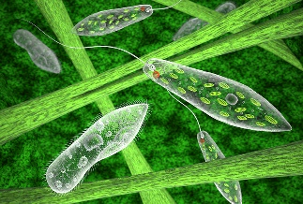
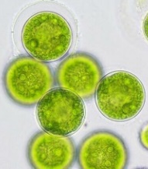
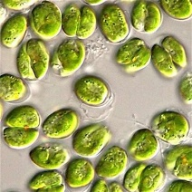
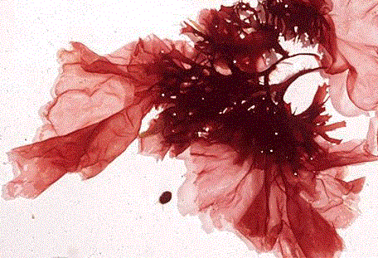
2.8. Vitamins
Almost all essential vitamins such as A, B1, B2, B3, B6, B12, C, E, biotin, folic acid and pantothenic acid are found in algae. Therefore, vitamins increase the nutritional value of algae. Algal species such as Dunaliella tertiolecta, Euglena gracilis, Nannochloropsis oculata, Spirulina platensis and Tetraselmis suecica produce vitamins C and E (Akyıl et al. 2016).
Porphyra sp. from red algae contains significant amounts of niacin, folic acid, A and C vitamins (Alçay et al. 2017).

Slide 11
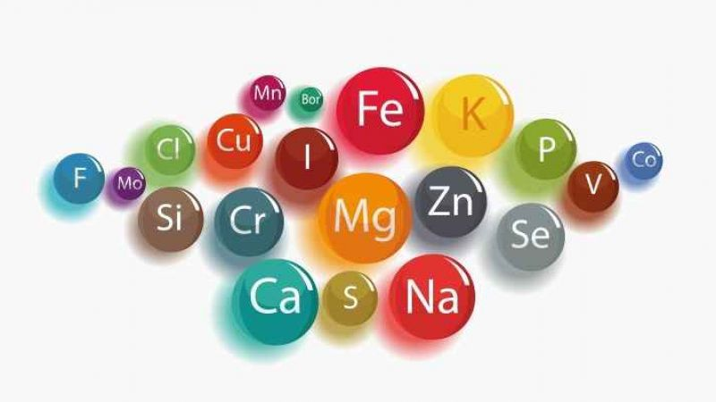
2.9. Minerals
Algae contain more minerals than terrestrial plants because they are in constant contact with water and absorb minerals directly. Algae contain calcium, magnesium, sodium, phosphorus, potassium, copper, zinc, iron, manganese, iodine, molybdenum and selenium.
However, green algae contain more calcium than red and brown algae. In contrast, red and brown algae tend to accumulate higher levels of sodium, potassium and zinc than green algae. (Polat and Polat, 2022).

Slide 12
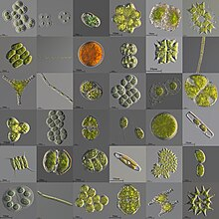
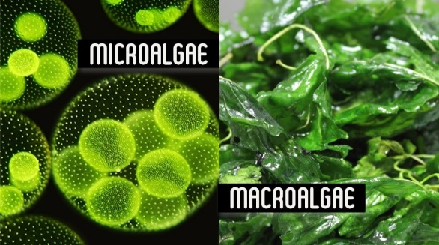
3. Conclusion
The bioactive component contents of algae may vary depending on the species, physiological state of the species, locality and season. Bioactive components provide color, taste and odor characteristics specific to algae, as well as protective properties against bacteria, viruses, fungi and parasites.
Algae are sustainable and excellent natural sources for the production of bioactive components. Since they can show a very rapid biomass increase, much higher amounts of bioactive components can be obtained from algae compared to terrestrial plants. Bioactive components obtained from algae are successfully used in many application areas such as food, cosmetics, energy, pharmacy and medicine.
Despite these benefits, the bioactive components of algae are still a new topic. As a result, more studies are needed on the bioactive components of algae, their mechanisms of impact and bioavailability. Thank you very much for listening to me.
I can answer any questions you may have on the subject, if any.

