Slide 1
Design, Synthesis and Computational Studies of Benzothiazol-2-ylmethyl-(x-halide-phenyl)-amine Derivatives as Anti-alzheimer Agents
Siddhi M. Chandak , Manoj R. Kumbhare , Vrushali P. Patole
Department of Pharmaceutical Chemistry, SMBT College of Pharmacy Dhamangaon, Nashik India-422403,
Affiliated to Savitribai Phule Pune University.

Slide 2
Introduction
In this study, the incorporation of halogenated phenyl groups and amine functionalities within benzothiazole frameworks has shown promise in enhancing bioactivity and selectivity.
Such modifications can modulate physicochemical properties, improve blood-brain barrier permeability, and enhance binding interactions with key molecular targets implicated in AD, such as acetylcholinesterase, beta-amyloid plaques, and tau proteins.
This study focuses on the design, synthesis, and computational analysis of benzothiazol-2-ylmethyl-(x-halide-phenyl)-amine derivatives as potential anti-Alzheimer’s agents.
By employing structure-based drug design (SBDD) approaches, we aim to evaluate pharmacokinetic parameters, activity spectra and molecular docking.

Slide 3
Synthetic Pathway:
Comp. Code | R
1a | P-Fluro
1b | P-Chloro
1c | O-Nitro
1d | 2-methyl, 5-nitro
1e | 4-chloro, 3-nitro

Slide 4
Methodology
1. Pharmacokinetic Studies
2. Activity Spectra Measurement
Evaluating pharmacokinetic parameters, such as absorption, distribution, metabolism, and excretion.
Performing molecular docking simulations to assess the binding affinities of the derivatives to key targets.
3. Molecular Docking
Determining the activity spectra of the synthesized derivatives against relevant Alzheimer's disease targets.

Slide 5
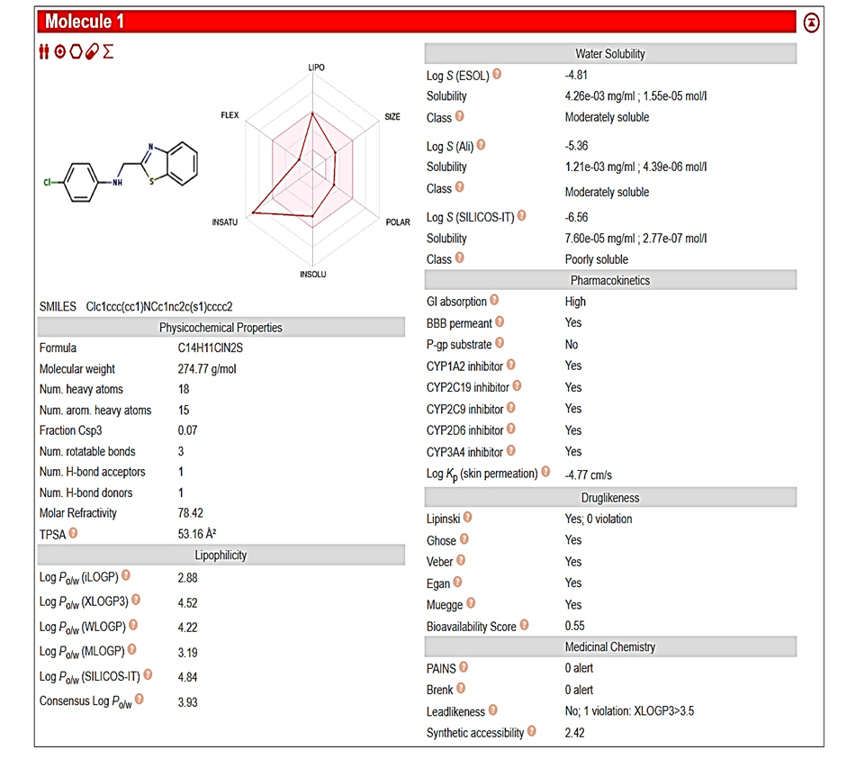
Pharmacokinetic Study

Slide 6
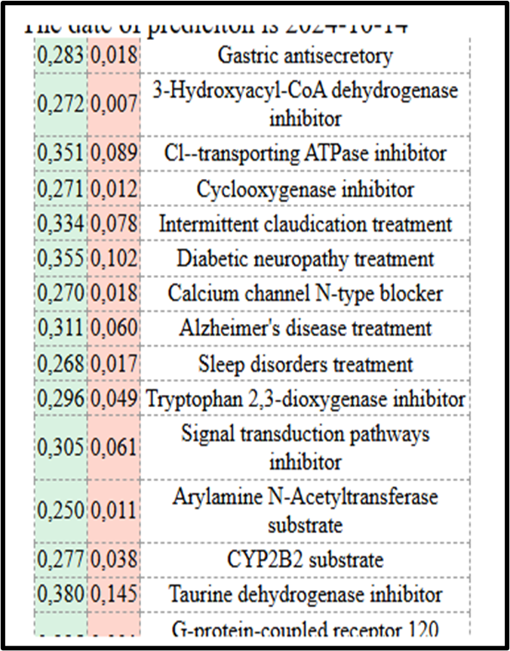
Activity Spectra Measurement

Slide 7
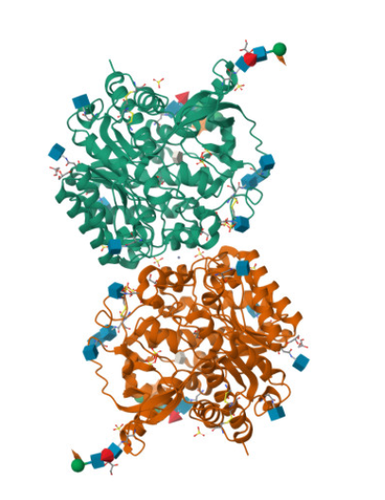
Molecular Docking Studies
Softwares Used :
Result
The docking scores, specific interactions and hydrogen bonds of the compounds with the target protein are displayed in the study. The Standard ligand for the 1e71 protein has a docking score of -6.3 kcal/mol while the designed compounds have -7.3, -7.6, -7.8, -7.3, -9.5 respectively.
The high docking scores and interaction patterns highlight the ability of these compounds to interact with crucial amino acids in the target protein's binding region, supporting their substantial biological activity.
Pymol Pyrax Drug Discovery
Protein &drug :
1e71
Drug

Slide 8
Result:
Sr. No. | Compound Code | Docking Score
1. | Galantamine (Std) | -9.9
2. | 1a | -8.9
3. | 1b | -8.4
4. | 1c | -9.0
5. | 1d | -9.6
6. | 1e | -9.4

Slide 9
Conclusion:
By integrating halogenated phenyl groups and amine functionalities within benzothiazole frameworks, these compounds exhibited enhanced bioactivity, selectivity, and blood-brain barrier permeability.
Molecular docking results further confirmed strong binding affinities, with Benzothiazol-2-ylmethyl-(2-methyl-5-nitro-phenyl)-amine achieving the highest docking score of -9.6, comparable to the standard drug Galantamine (-9.9).
The outcomes underscore the efficacy of the structure-based drug design approach in identifying potential therapeutic agents for Alzheimer's disease, paving the way for further experimental validations and clinical studies.

Slide 10
Future Directions:
In Vivo Studies
1
Conduct in vivo studies to evaluate the therapeutic efficacy of these compounds.
Structure-Activity Relationship
2
Investigate the structure-activity relationship to optimize the antioxidant properties.
Drug Development
3
Explore the potential for developing these compounds into novel therapeutic agents.

Slide 11
Thank You

