Slide 1
Title: The Role of Hygiene and Ethical Practices in Safeguarding Food Safety and Public Health: A Comprehensive Approach to a Sustainable Food System
Fatemehsadat Mirmohammadmakki¹
Mahmoud Abbasi ¹
Mahdi Shadnoush *²
1 Medical Ethics and Law Research Center, Shahid Beheshti University of Medical Sciences, Tehran, Iran
2 Faculty of Nutrition and food Technology, Shahid Beheshti University of Medical Sciences, Tehran, Iran

Slide 2
Abstract
The journey of food from farm to table
significantly impacts
public health
Food hygiene
is essential at every stage
to ensure food safety and quality

Slide 3
A lack of hygiene
can lead to food-borne illnesses caused by
bacteria
viruses
parasites
which negatively impact individuals and strain public healthcare systems.

Slide 4
Introduction
Food hygiene plays a fundamental role in safeguarding public health
It extends beyond personal health to include economic stability and environmental sustainability
Ethical principles in food hygiene are essential for a sustainable food system

Slide 5
Food Hygiene and Public Health
Food-borne diseases result from microbial contamination at various stages of food production
Common pathogens include
Salmonella
Escherichia coli
Listeria
Strict hygiene measures are necessary to prevent outbreaks and protect public health

Slide 6
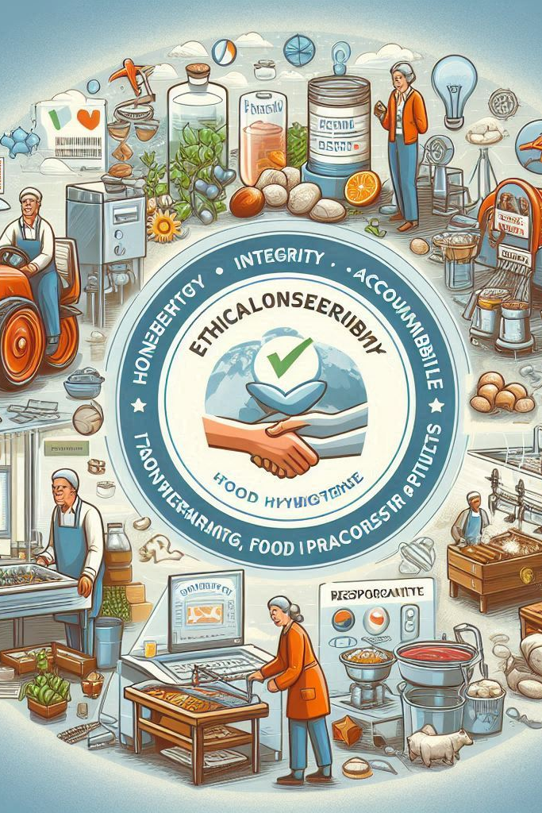
Ethical Responsibilities in Food Hygiene
Ethical considerations focus on honesty, integrity, and accountability.
Farmers, food processors, and consumers share responsibility in maintaining hygiene standards.
Transparency in food labeling and responsible practices reinforce consumer trust.

Slide 7
Hygiene Protocols in the Food Supply Chain
Food hygiene measures must be implemented at every stage of the food supply chain
From clean water sources in agriculture to HACCP systems in food processing, strict protocols minimize contamination risks

Slide 8
Agricultural Hygiene Practices
Ensuring hygiene starts with
controlled pesticide use
proper waste management
clean irrigation systems
Maintaining sanitary conditions in harvesting
storage
is crucial for preventing contamination

Slide 9
Food Processing Hygiene Standards
Processing facilities
must follow sanitation protocols, including thorough
equipment cleaning
strict worker hygiene measures
Regular inspections
hygiene training
reduce contamination risks

Slide 10
Food Storage and Distribution Hygiene
Temperature control is critical to preventing food spoilage.
Cold chain management ensures perishable food safety.
Proper packaging and transportation conditions protect food quality.

Slide 11
Consumer Responsibilities in Food Safety
Proper washing, cooking, and storage reduce risks of contamination and pathogen growth.
Consumers must handle and store food safely to prevent food-borne illnesses.

Slide 12
Societal Benefits of Food Hygiene
Proper food hygiene improves public health, reduces healthcare costs, and enhances economic productivity.
It also minimizes environmental impacts by reducing food waste and unnecessary chemical use.

Slide 13
Regulatory Framework and Food Safety Standards
International agencies like WHO and FDA establish hygiene and safety guidelines
Governments enforce regulations to ensure compliance across the food industry.

Slide 14
Technological Advances in Food Hygiene
New technologies such as
AI-driven monitoring
blockchain for traceability
automated sanitation systems
improve food safety management

Slide 15
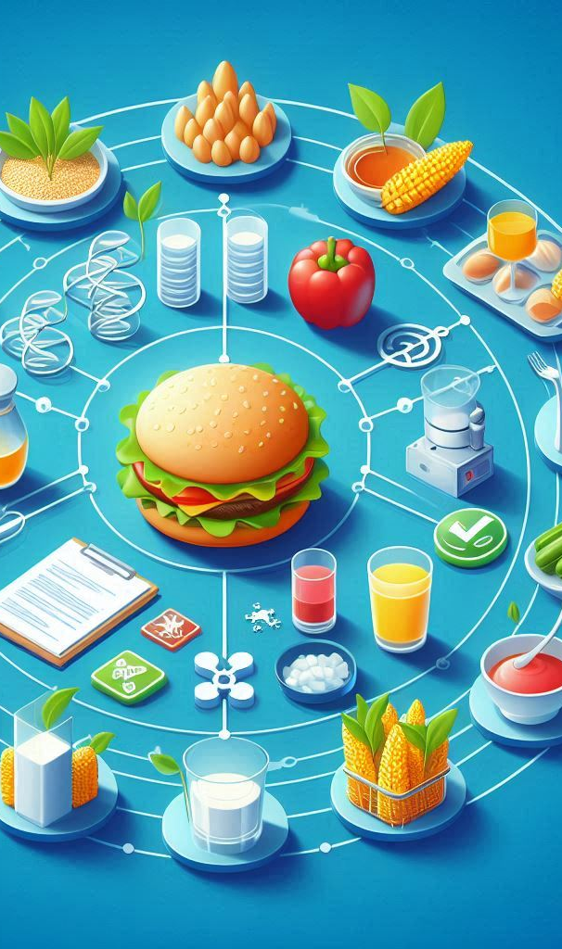
Challenges in Implementing Food Hygiene
Barriers such as:
economic constraints
regulatory enforcement gaps
lack of public awareness
Causing:
prevent effective food hygiene implementation
particularly in developing regions

Slide 16
Future Trends in Food Safety and Hygiene
will shape the future of food hygiene
Increasing reliance on AI-driven food safety monitoring
enhanced consumer education
stricter regulations

Slide 17
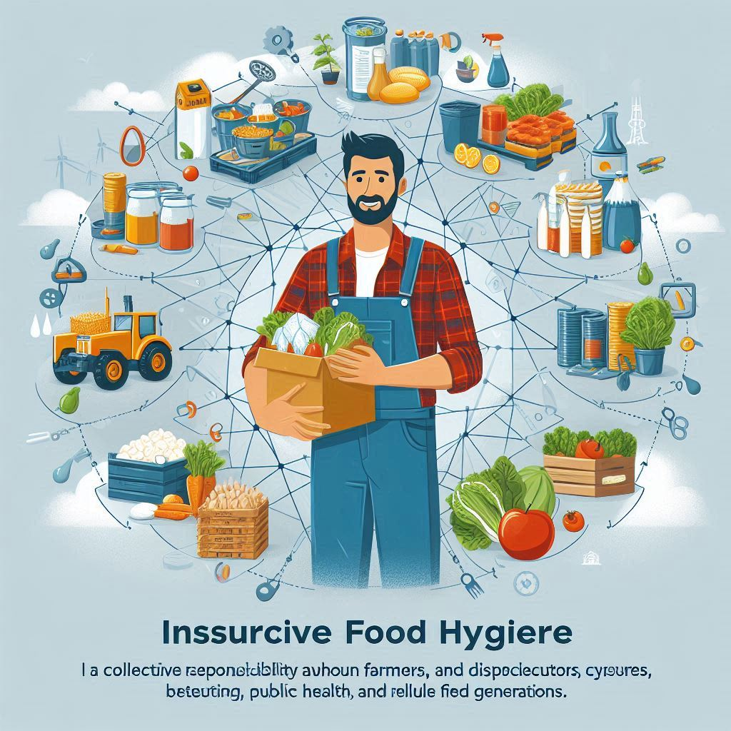
Conclusion
Ensuring food hygiene is a collective responsibility among farmers, processors, distributors, and consumers.
Implementing comprehensive hygiene measures ensures a sustainable and reliable food system, benefiting public health and future generations.

Slide 18
Thank You For Your Attention

