Slide 1
Analysing of mental health in human using AI technique
Prof. (Dr.) Ekbal Rashid
Professor,
Department of Computer Science and Engineering
SRM University, Sonepat, Haryana, India

Slide 2
Abstract
Today's era is the Artificial Intelligence (AI) era and the use of artificial intelligence in human mental health trials opens the way for a period of transformation in which the potential to enhance efficiency, precision, and scope in the study of mental health in human beings is enormous. In this perspective, the promise and threats of AI regarding mental health are critically reviewed. On one hand, it's where AI can really make some revolutionary changes to the most critical aspects of examination and execution—like patient treatment, data management, and predictive analytics—which are now adaptive and more driven by data; on the other hand, AI applied to mental health in human beings. This study presents a case for strong AI frameworks that are subject to firm validation and ethical scrutiny, which will ensure that the technique of AI is utilised with reduced risks associated with it.
KEYWORDS: Mental Health, Artificial Intelligence, Human beings, Patient Outcomes, Predictive Analytics,
Place your data in this space

Slide 3
Introduction
AI technique has been applied in human mental health for the next generation which offers a vision for potential applications of AI technologies, and it has been accepted globally [1]. General efforts have also applied for increasing the adoption of AI techniques. Further, there are big hopes for emerging AI technology in the world. The main idea behind this technology is people acceptability and accuracy faster round the globe. One of the important techniques of AI is Artificial Neural Networks (ANNs) that build on the area of connection with the main purpose of mimicking the way the nervous system possesses information. ANN and variants have allowed significant progress. ANN is capable of taking inputs and giving them in an Intelligent way as an output.

Slide 4
Artificial intelligence (AI) can help overcome depression in several ways:
Chatbots and Virtual Assistants: AI-powered chatbots offer emotional support, listen actively, and provide coping strategies.Example: Woebot, a mental health chatbot, uses natural language processing to monitor mood and offer personalized advice.
Mood Prediction and Tracking: AI analyzes speech, text, or social media patterns to identify early warning signs of depression. Example: Moodfit, an AI-powered mood-tracking app, monitors emotions and provides personalized recommendations.
Personalized Therapy Recommendations: AI-driven systems analyze individual profiles to suggest tailored therapy approaches. Example: IBM's Watson for Mental Health uses machine learning to recommend personalized therapy plans.
Place your data in this space

Slide 5
Cont.…
Virtual Reality (VR) Exposure Therapy: AI-driven VR environments help individuals confront and overcome fears and anxieties. Example: Oxford VR's AI-powered VR therapy treats depression and anxiety disorders.
Social Support Networks: AI-facilitated online communities connect individuals with peers and mental health professionals. Example: 7 Cups, an AI-powered online support network, connects users with trained listeners and therapists.

Slide 6
Cont…
Predictive Analytics: AI identifies high-risk individuals and forecasts depression onset. Example: Researchers used machine learning to predict depression in adolescents based on social media activity.
Cognitive Behavioral Therapy (CBT) Bots: AI-driven CBT bots offer automated, interactive therapy sessions. Example: AI-powered CBT bot, Wysa, provides emotional support and coping strategies.
Sentiment Analysis: AI analyzes speech and text patterns to detect emotional changes. Example: Researchers used sentiment analysis to detect depression in social media posts.

Slide 7
Cont…
Neurofeedback Training: AI-driven neurofeedback systems help individuals control brain activity. Example: Neurofeedback training using EEG and AI helps manage depression symptoms.
Telemedicine and Access Expansion: AI-powered platforms increase access to mental health services. Example: AI-driven telemedicine platforms like Amwell and Doctor on Demand expand mental health services.
These AI-driven solutions augment traditional treatments, enhance accessibility, and provide personalized support.

Slide 8
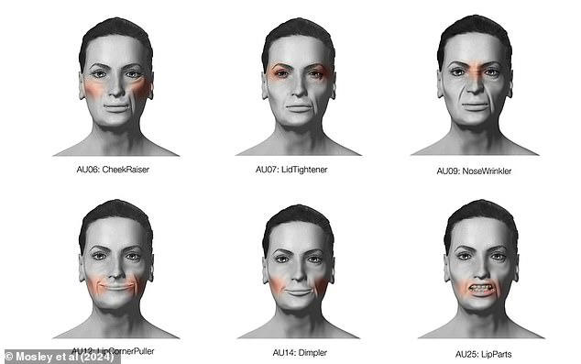
The facial expressions that can reveal if someone is suffering severe depression
Place your data in this space

Slide 9
References:
National Institute of Mental Health (NIMH)
- American Psychological Association (APA)
- Journal of Clinical Psychology
- IEEE Transactions on Affective Computing

Slide 10
Thank You

