Slide 1
Title: Oscillatory volume flow rate of a Non-Newtonian fluid flow through porous material
Dr. Awaneesh Jee Srivastava
United College of Engineering & research, Prayagraj-211010, U.P- INDIA

Slide 2
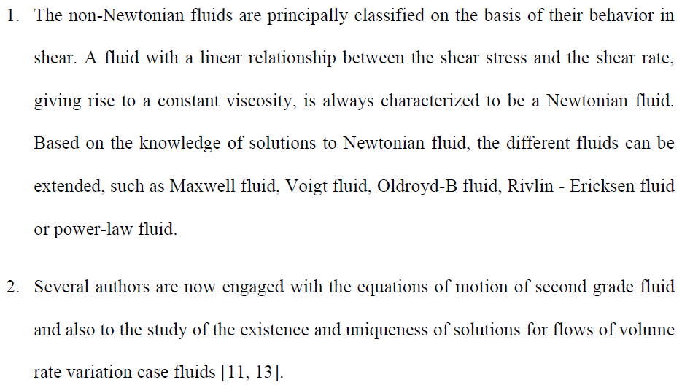
Introduction:
The non-Newtonian fluids are principally classified on the basis of their behavior in shear. A fluid with a linear relationship between the shear stress and the shear rate, giving rise to a constant viscosity, is always characterized to be a Newtonian fluid. Based on the knowledge of solutions to Newtonian fluid, the different fluids can be extended, such as Maxwell fluid, Voigt fluid, Oldroyd-B fluid, Rivlin - Ericksen fluid or power-law fluid.
Several authors are now engaged with the equations of motion of second grade fluid and also to the study of the existence and uniqueness of solutions for flows of volume rate variation case fluids [11, 13].
App. Math. Comput. 137 (2) pp. 437-450.
ASME J. Appl. Mech. 67 pp. 274-281

Slide 3
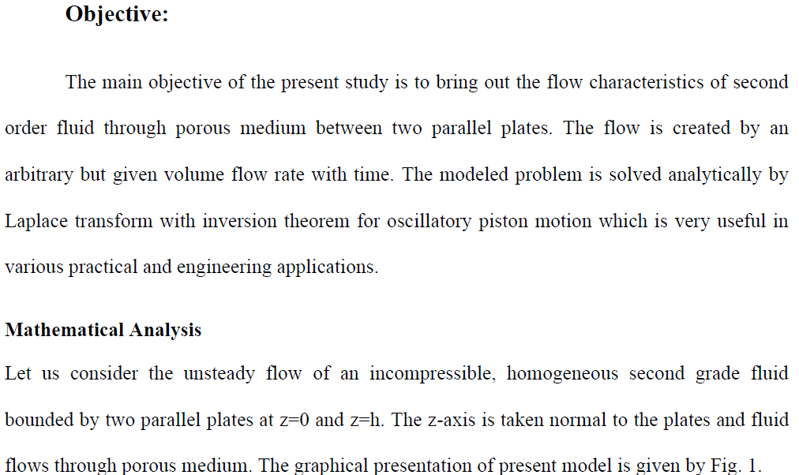
Objective:
The main objective of the present study is to bring out the flow characteristics of second order fluid through porous medium between two parallel plates. The flow is created by an arbitrary but given volume flow rate with time. The modeled problem is solved analytically by Laplace transform with inversion theorem for oscillatory piston motion which is very useful in various practical and engineering applications.

Slide 4
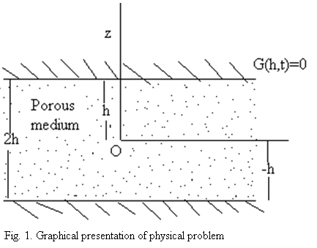
Mathematical Analysis
Let us consider the unsteady flow of an incompressible, homogeneous second grade fluid bounded by two parallel plates at z=0 and z=h. The z-axis is taken normal to the plates and fluid flows through porous medium. The graphical presentation of present model is given by Fig.

Slide 5
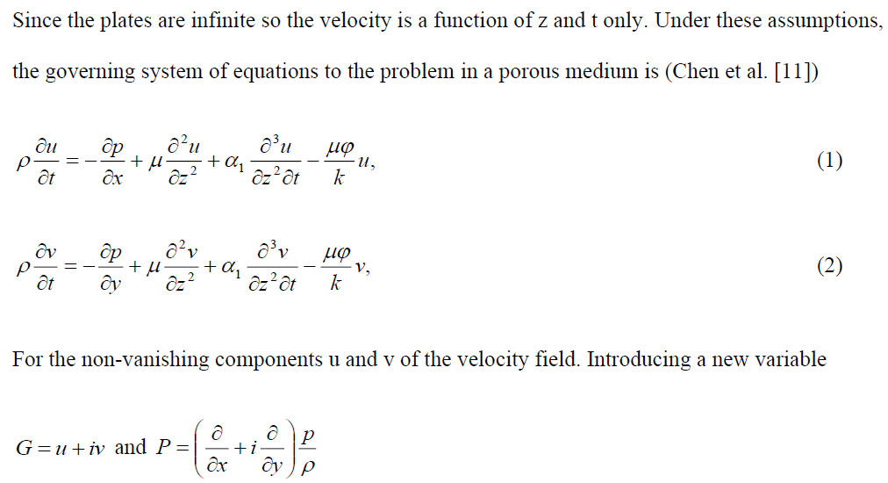
Since the plates are infinite so the velocity is a function of z and t only. Under these assumptions, the governing system of equations to the problem in a porous medium is (Chen et al. [11])
(1)
(2)
For the non-vanishing components u and v of the velocity field. Introducing a new variable
and
Now we have
(3)

Slide 6
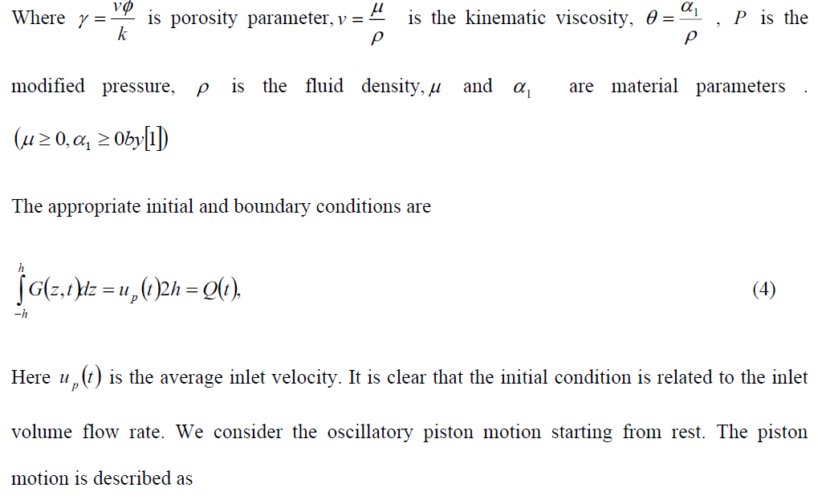
Where is porosity parameter, is the kinematic viscosity, , is the modified pressure, is the fluid density, and are material parameters .
The appropriate initial and boundary conditions are
(4)
Here is the average inlet velocity. It is clear that the initial condition is related to the inlet volume flow rate. We consider the oscillatory piston motion starting from rest. The piston motion is described as

Slide 10
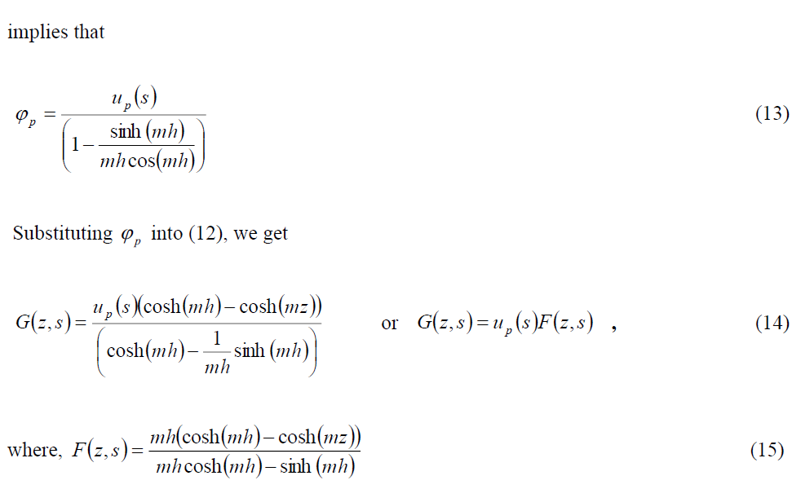

Slide 11
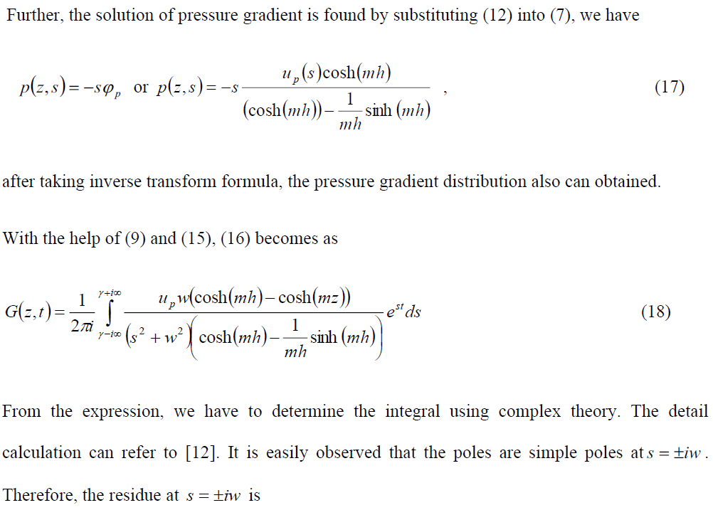

Slide 12
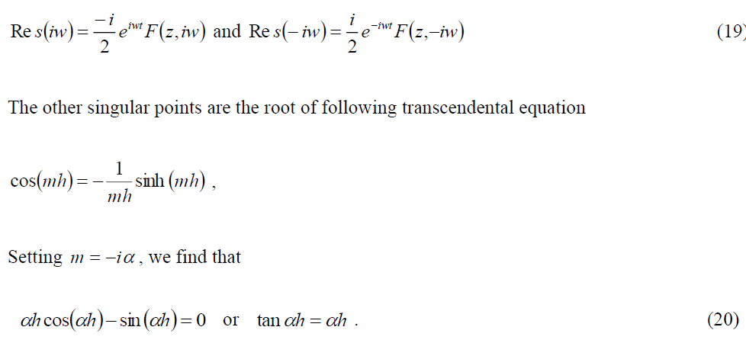

Slide 13
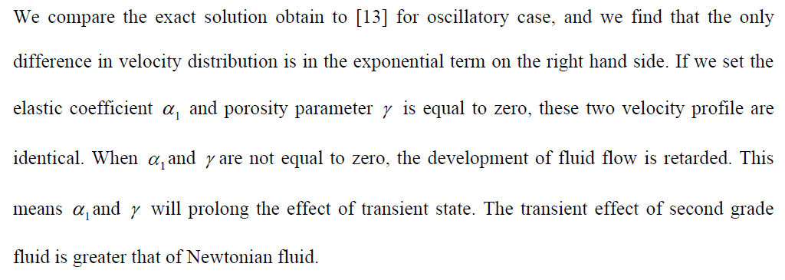

Slide 14
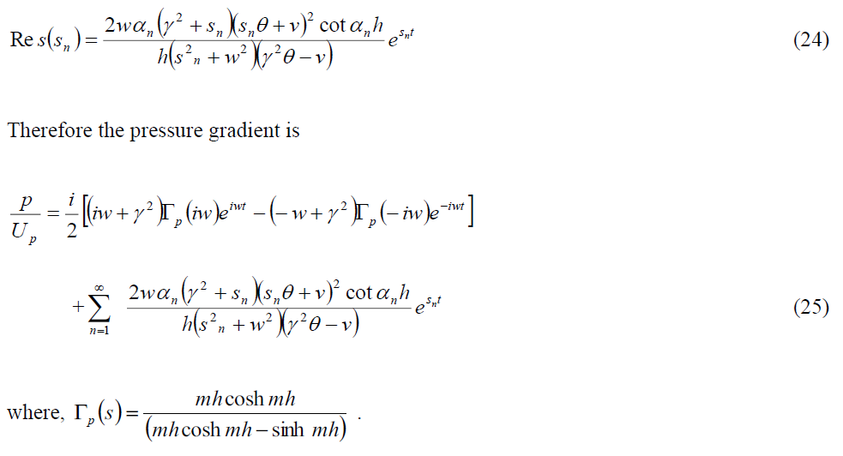

Slide 15
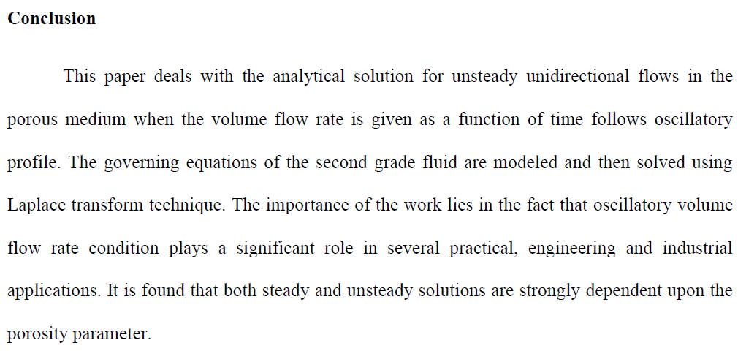
Thank You

